Slide 1
Latino Action Network et al. (LAN) v. New Jersey:
Observations
Robert Kim, Executive Director, Education Law Center
The Unfinished Legacy of Brown v. Board at 70 Conference
Stanford University
May 6, 2024

Slide 2

Education Law Center
Education Law Center (ELC) pursues justice and equity for public school students nationwide by enforcing their right to a high-quality education in safe, equitable, non-discriminatory, integrated, and well-funded learning environments.
Areas of Focus: School Finance; Public Funds for Public Schools (anti-voucher); Student Rights/Anti-Discrimination
ELC has joined as co-counsel in two state court desegregation lawsuits: Latino Action Network v. NJ and Cruz-Guzman v. MN
Abbott v. Burke litigation history in NJ
School funding, poverty, and race in NJ
  Average Black and Latino student attends district that is over 50% economically disadvantaged
  The average Black and Latino student attends a district that is spending 1-2K less per pupil than what’s required under funding formula to achieve adequate education; average white student attends district that spends 1K more
  Lack of quality education due to inequitable funding is exacerbated by racial segregation, which makes it harder to close funding gaps and may even drive inequitable funding and resources (Johnson 2019)
Notes:
ELC is known for our advocacy to foster equitable and sufficient school funding and resources. In recent decades, New Jersey has made significant strides in meeting its obligation to provide equitable funding and resources for low-income students and students of color, most notably through the Abbott v. Burke litigation.

Slide 3
Segregation in NJ Schools
New Jersey Public Schools – Fall 2023
  1,379,988 Students
  10% Asian
  14% Black
  34% Hispanic
  38% White
  4% Other Race
  12% Poverty
  Data Sources: NJDOE Fall Enrollment report 2023-24, NJDOE Charter State Aid Notices 2022-23, ELC estimates for updated DFG calculations for 2021 of district poverty using (Census American Community Survey data 2017-2021), Census Small Area Income Poverty School District Estimates 2022
26 school districts are 90% or above Black and Hispanic student enrollment; 43 districts are 10% white student enrollment or less (~305,000 or 22% of all students)
Almost half of Black and Latino students attend schools that are 90% non-white or more (Coughlan 2021)
In recent times, NJ ranked #5 among states in level of intense segregation experienced by Black students; #4 for Latino students
Notes:
ELC is known for our advocacy to foster equitable and sufficient school funding and resources. In recent decades, New Jersey has made significant strides in meeting its obligation to provide equitable funding and resources for low-income students and students of color, most notably through the Abbott v. Burke litigation. Despite these gains in school funding equity, nearly 70 years after Brown v. Board, schools in New Jersey and across the nation remain deeply segregated by race. New Jersey students continue to be educated in schools that are among the most segregated in the nation. New Jersey has the fifth-highest level of intense segregation among Black students and the fourth-highest level among Latinx students. Students of all races in NJ are deprived the opportunity to learn in diverse learning environments, which is critical not only for their development and education but for our democracy as a whole.
The primary drivers of entrenched school segregation in New Jersey include the residential segregation and lack of affordable housing that permeate the state. In New Jersey, like many other northeastern states, the historical ramifications of property-tax-funded schools, white flight, redlining, and other racist housing policies have resulted in highly segregated school district boundaries that mirror highly segregated municipalities.

Slide 4
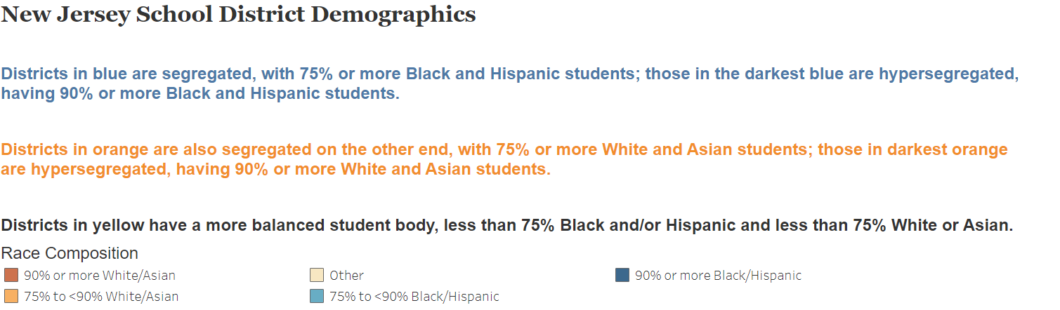
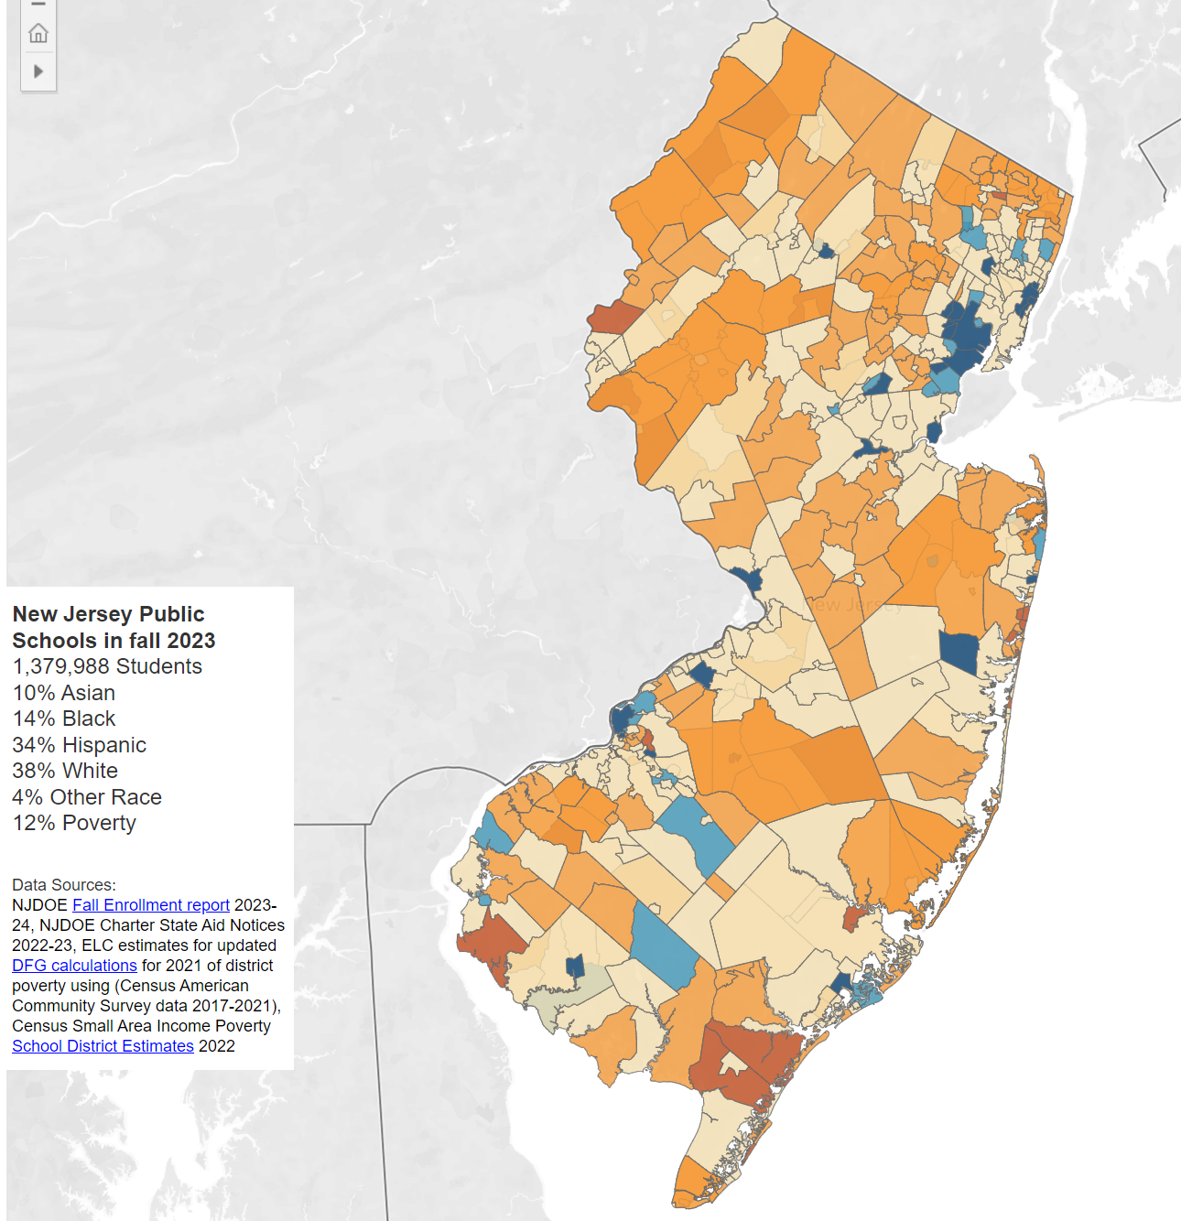
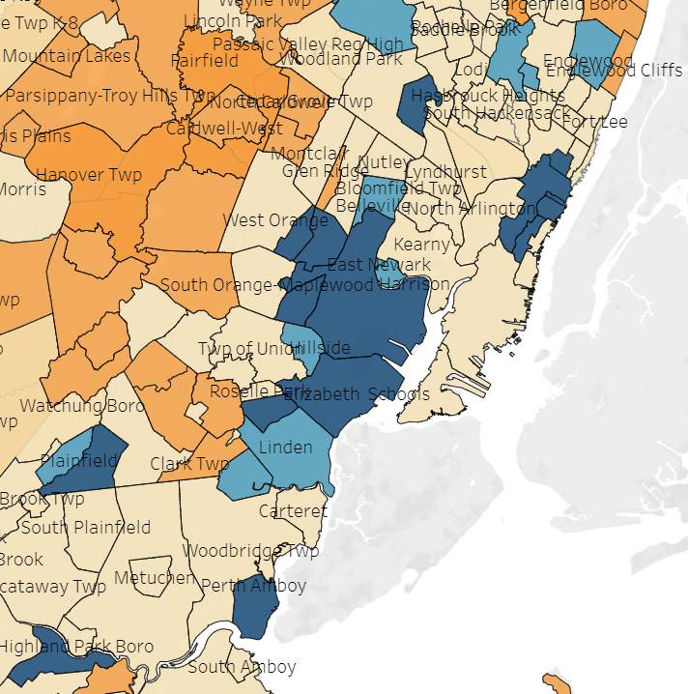

Slide 5
What is the LAN case is about
Filed in 2018 in NJ Superior Court; ELC joined in 2023
Statewide desegregation case
Alleges violations of state constitutional desegregation clause; education clause; equal protection; and statutory provisions
October 2023: court ruled against state, holding that it has a constitutional obligation to address desegregation, but also declined to hold state liable for segregated schools without further evidence
Case is on suspended appeal pending mediation discussions

Slide 6
Challenges ahead
Remedies – Scope, Scaling, Sequencing, Sector Silos
Charters, choice, voucher policies
Fiscal, Political Challenges
Community Perceptions, Engagement
Collaboration and Planning Between Researchers and Litigators

Slide 7
Research and policy (and legal remedy) questions
What is “segregation”? What is acceptable “desegregation”? What is “integration”?
Student interdistrict mobility vs. district consolidation vs. non-educational/cross-sector policies?
How can school finance formulas encourage integration?
How do you desegregate high-poverty districts while improving the education and conditions for all students within those districts?

