Slide 1


Parents, Preferences, & School Segregation
Marissa E. Thompson
Notes:
Image Credit: Norman Rockwell

Slide 2

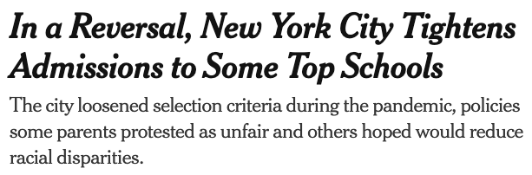


Slide 3
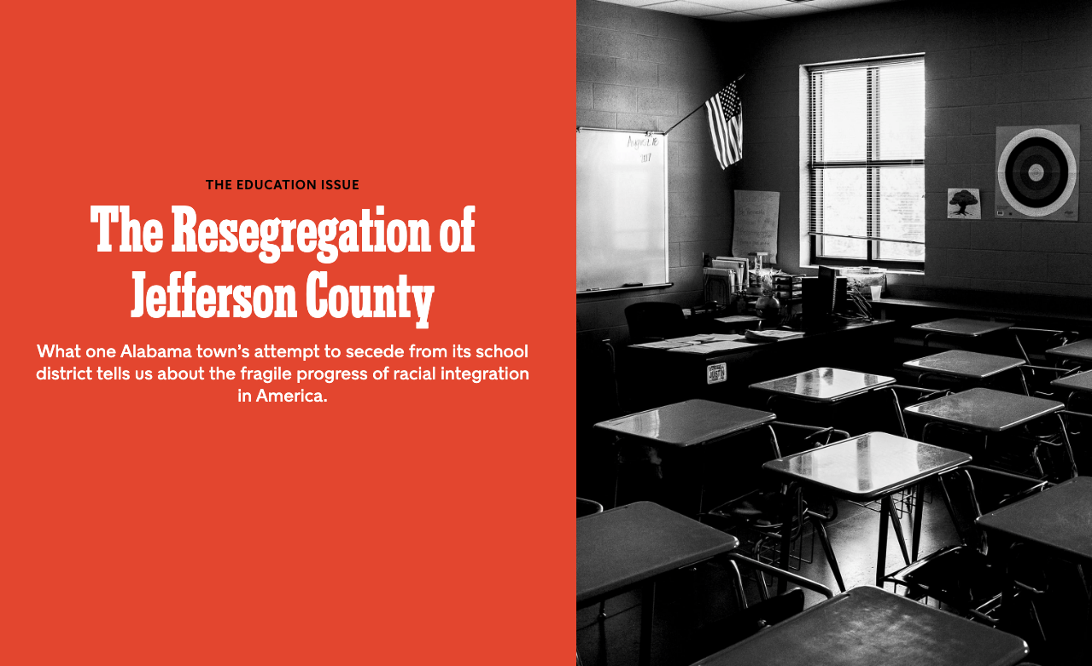

Slide 4
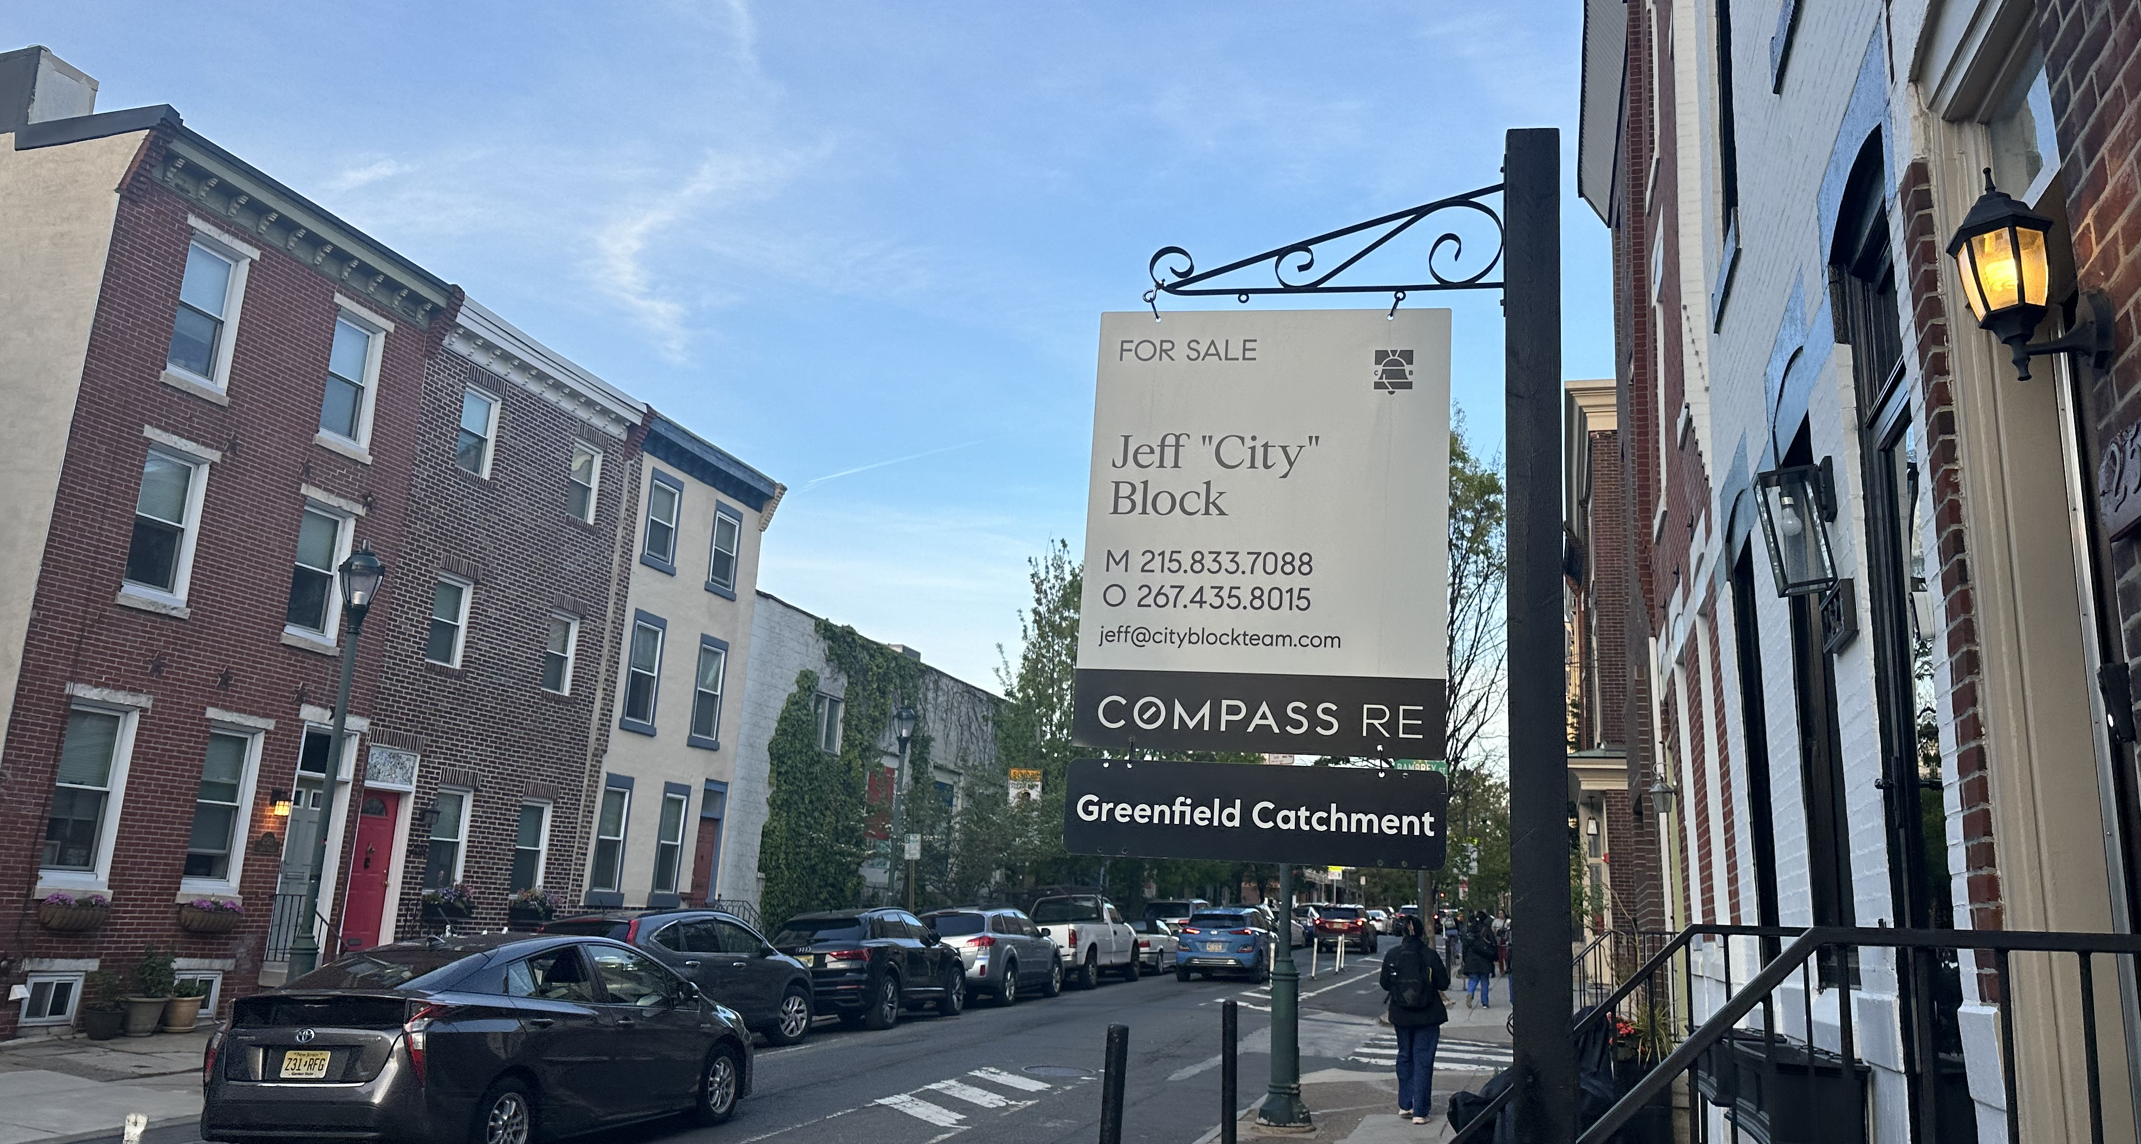
How do parents choose & evaluate schools?
The ”package deal” of home and school (Rhodes & Warkentien 2017; Goyette and Lareau 2014; Owens et al. 2016; Reardon and Bischoff 2011’ Roda and Wells 2013; Posey-Maddox 2014)
School choice options (Rich, Candipan, and Owens 2021; Pearman and Swain 2017; Saporito and Sohoni 2006; Schachner 2022; Candipan 2020)
Opinions of other advantaged parents (Burdick Will et al 2020; Fong 2019; Holme 2002; Rhodes and Warkentien 2017)
School attributes
  (Perceived) school quality and effectiveness (Harris and Larsen 2015; Houston & Henig 2023)
  Racial & socioeconomic composition (Billingham & Hunt 2016; Hailey 2022; Thompson forthcoming; Holme 2002;
  Thompson & Trejo 2024; Harris and Larsen 2015)
  Safety, extracurricular options, travel time, etc... (Hailey 2022; Harris and Larsen 2015; Burdick-Will et al. 2023; Glazerman and Dotter 2017)

Slide 5
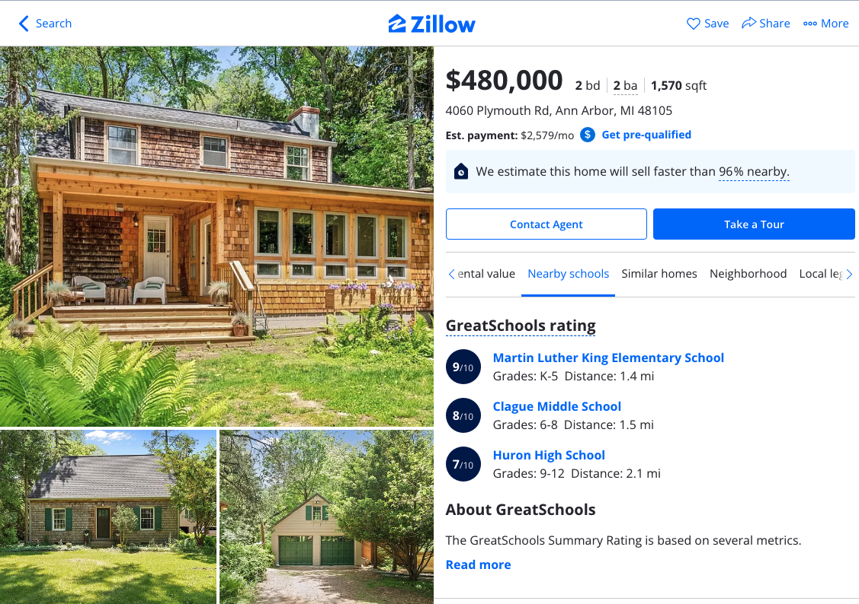
(Hasan and Kumar 2019; McArthur and Reeves 2022)

Slide 6
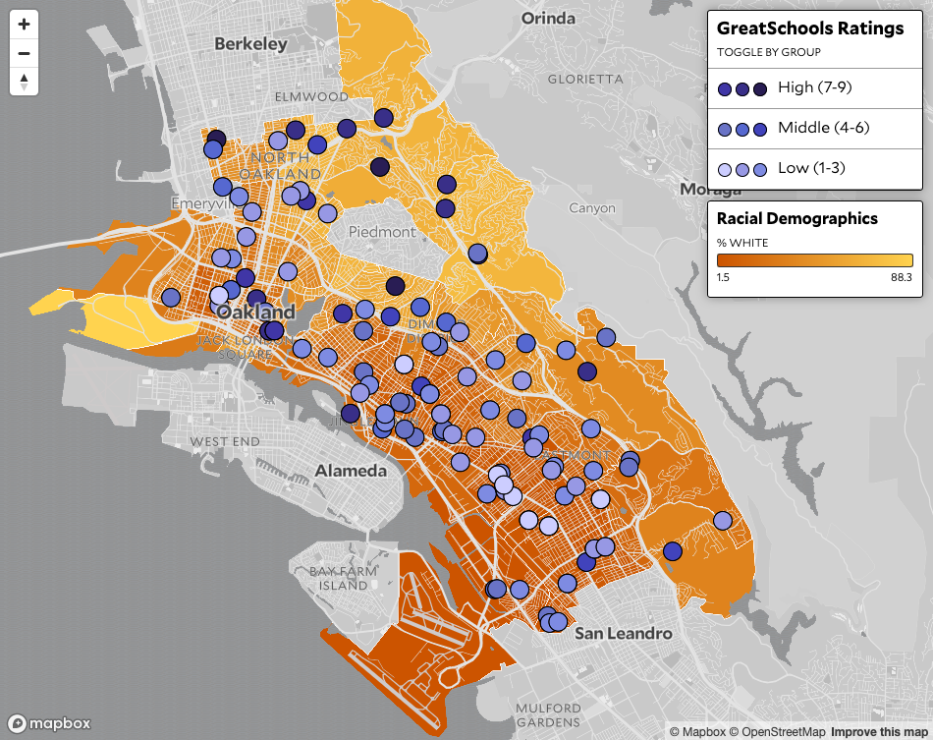



Slide 7
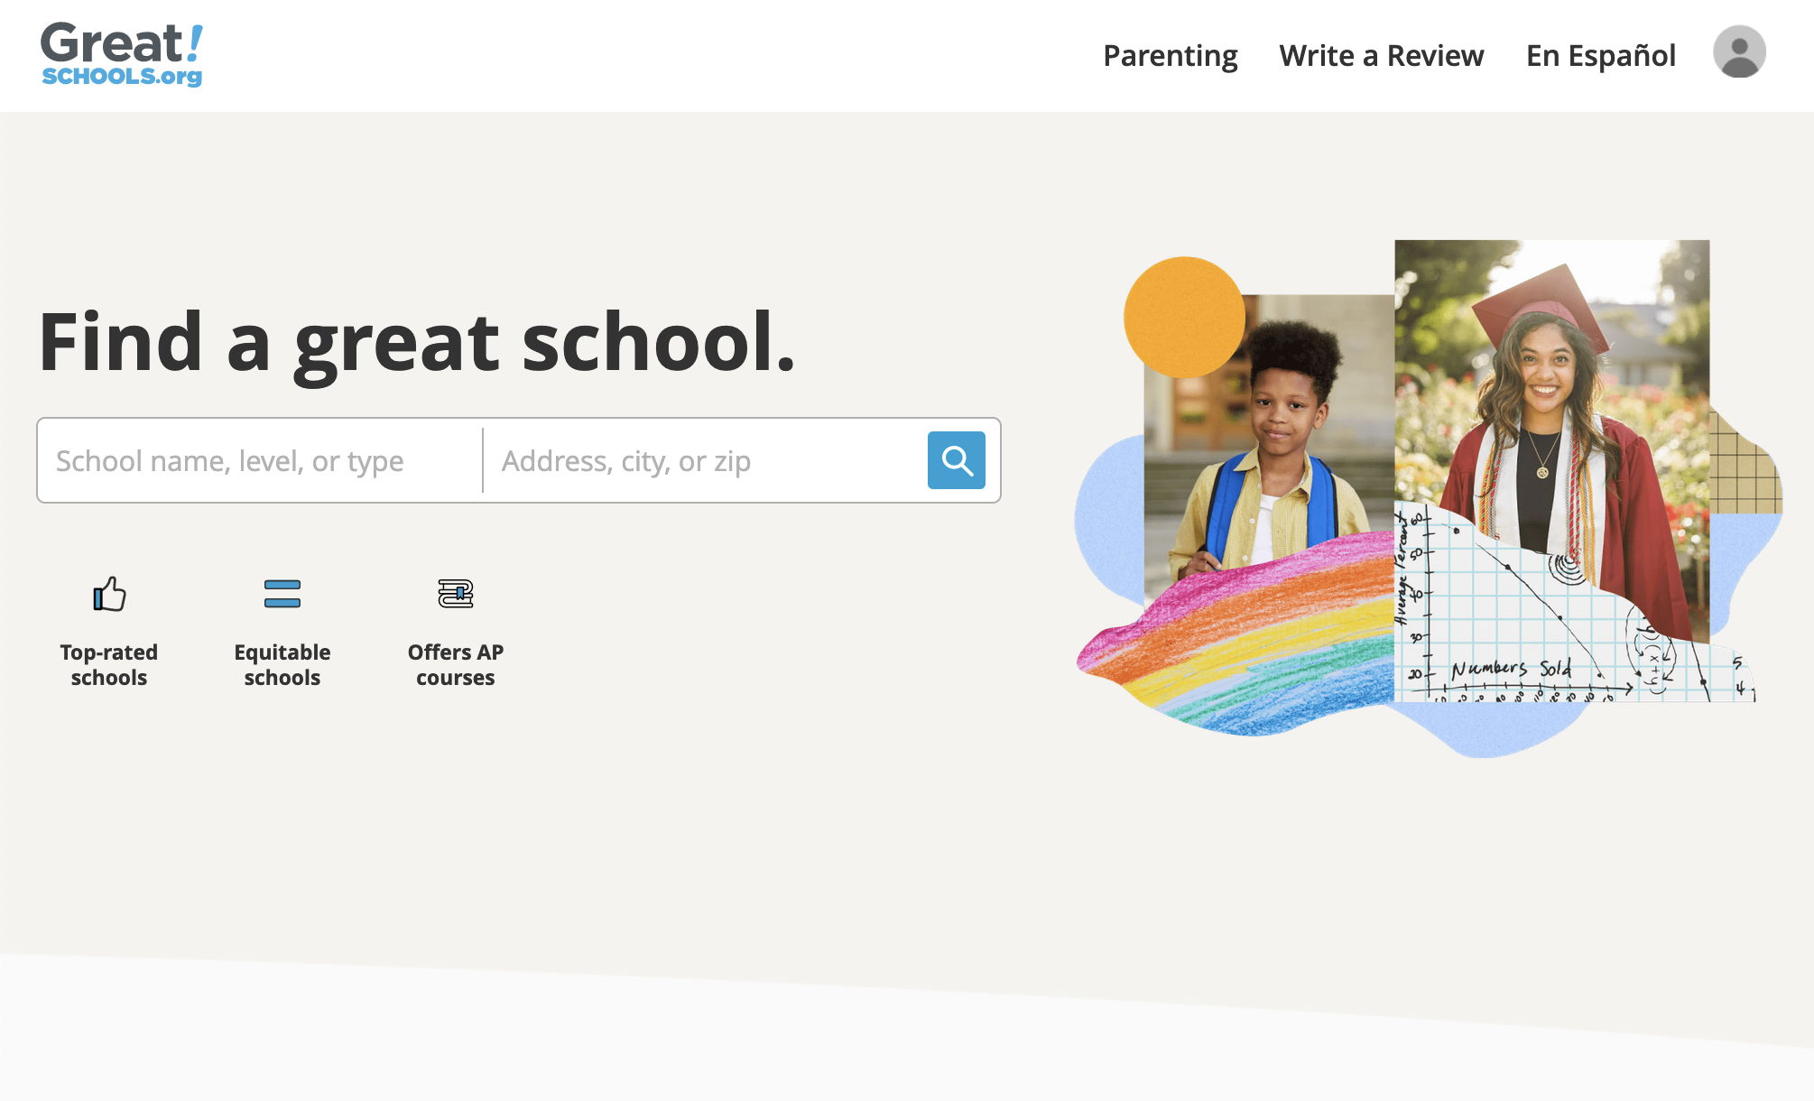
Ann Arbor, Michigan

Slide 8
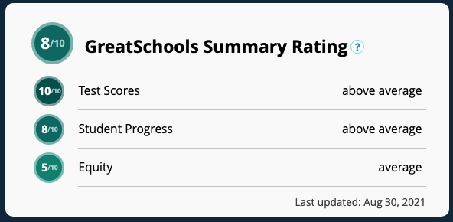

Slide 9

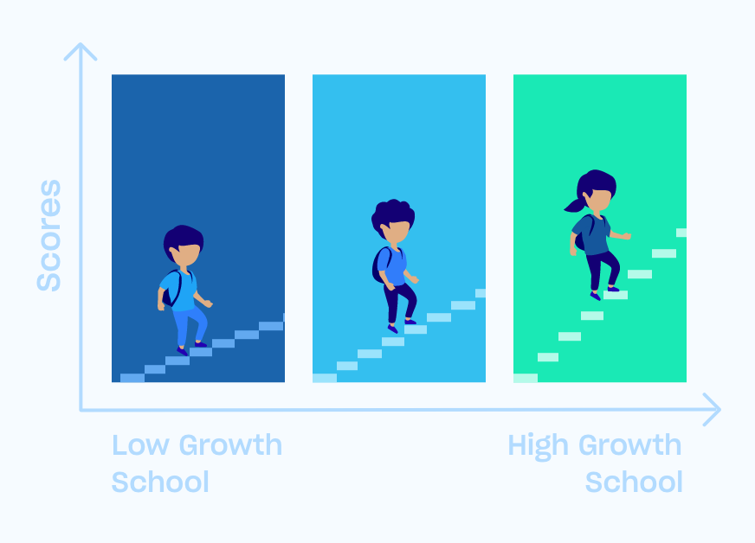

Average Test Score
Learning Rate

Slide 10
Houston & Henig 2023; Valant & Weixler 2022; Thompson forthcoming; Houston et al. 2021; Hailey 2022; Mellon & Siegler 2023; Billingham & Hunt 2016

Slide 11
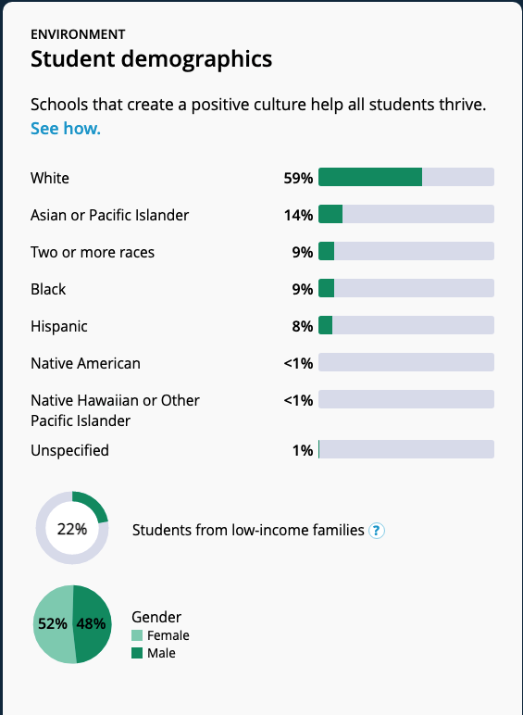
Houston & Henig 2023; Valant & Weixler 2022; Thompson forthcoming; Houston et al. 2021; Hailey 2022; Mellon & Siegler 2023; Billingham & Hunt 2016

Slide 12

Image Source: PBS

Slide 13
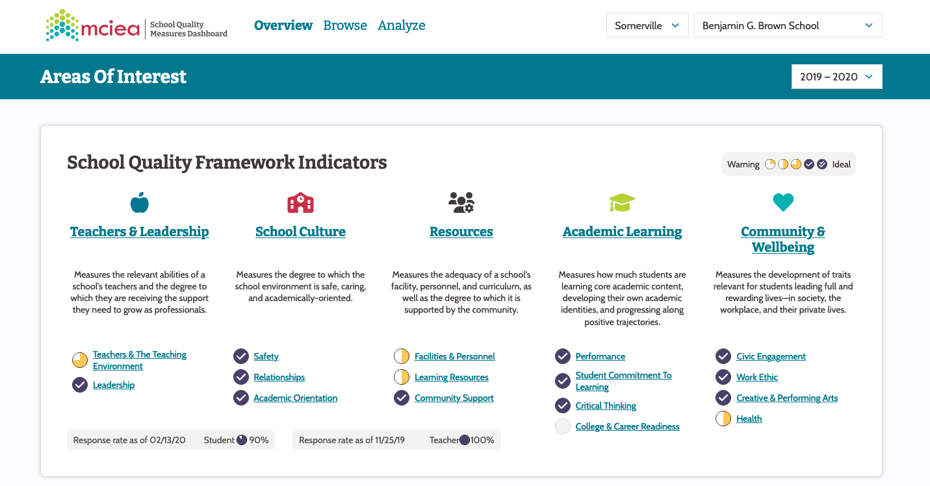
Notes:
Massachusetts Consortium for Innovative Education Assessment (MCIEA)

Slide 14



Slide 15
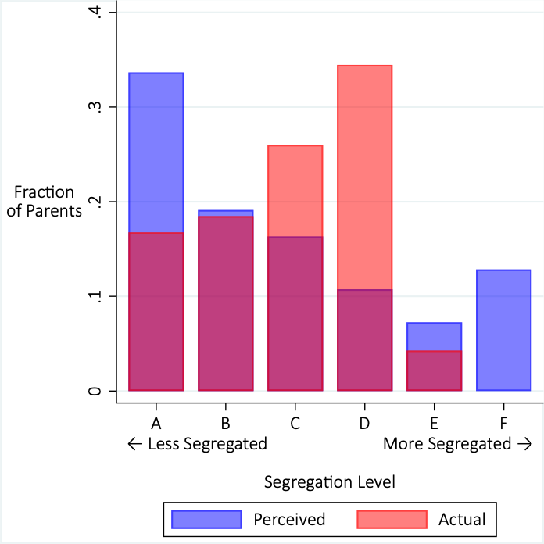
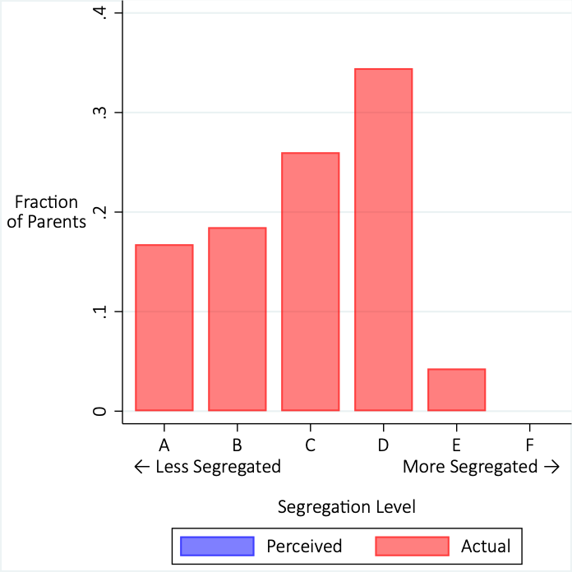
  Thompson & Trejo 2024

Slide 16
Thank you!
marissaethompson.com
Notes:
Image Credit: Norman Rockwell
I wish I was leaving you with more answers, but a lot of what I have are questions

