Slide 1



Student Assignment Policy,
Integration, and Educational Equity
Irene Lo
Stanford MS&E

Slide 2

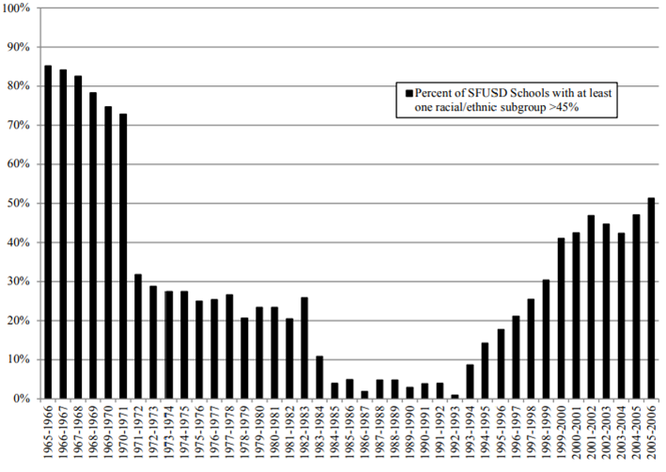
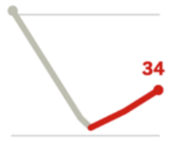
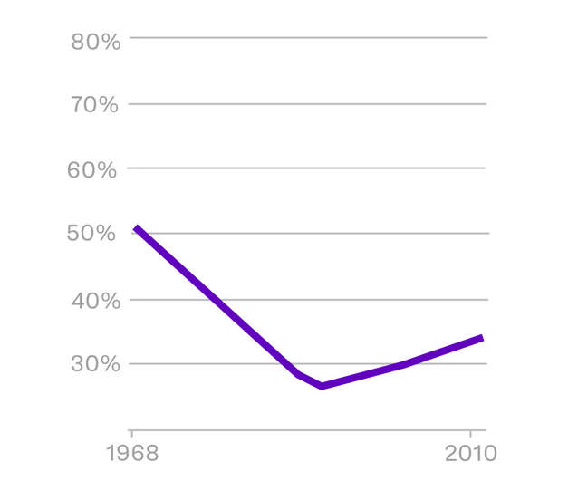
Schools are resegregating
Percentage of black students in the West of the US who attend schools that are at 90 to 100% minority
Percentage of schools in SFUSD with at least one racial subgroup comprising >45%
51%
34%
Data from the US Department of Education’s National Center for Education Statistics and Office of Civil Rights, via UCLA’s Civil Rights Project
Image source: https://www.bostonglobe.com/2020/12/11/opinion/massachusetts-public-schools-are-highly-segregated-its-time-we-treated-that-like-crisis-it-is/
Figure sources: https://www.vox.com/2018/3/5/17080218/school-segregation-getting-worse-data
https://www.sfusd.edu/facing-our-past-changing-our-future-part-ii-five-decades-desegregation-sfusd-1971-today
Notes:
https://www.vox.com/2018/3/5/17080218/school-segregation-getting-worse-data

Slide 3

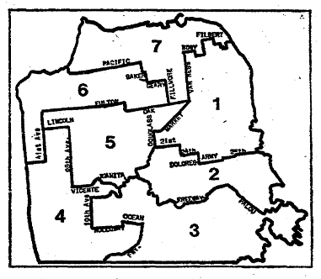



Student assignment matters!
But faces challenges…
1971
Race-conscious policies
Percentage of schools in SFUSD with at least one racial subgroup comprising >45%
Horseshoe
Policy
#
2002
Race-blind policies
#
2011
School Choice
Notes:
Brown vs Board 1954
The Horseshoe Plan/Operation Integrate (1971–1978) [Zoning + centralized assignment + busing]
Educational Redesign (1978–1983) [Initial assignment + limited choice]
Optional Enrollment Request (OER) Student Assignment System (1983–2000) [Zoning + centralized assignment + citywide schools + limited choice + busing]
Diversity Index Lottery (2002–2010)

Slide 4
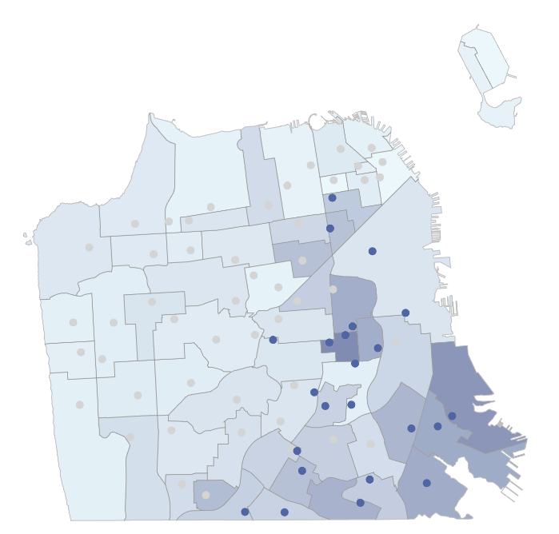
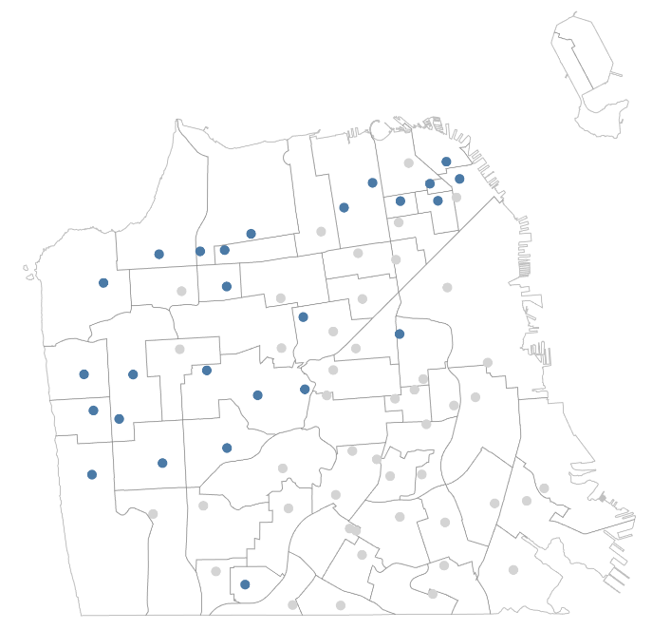
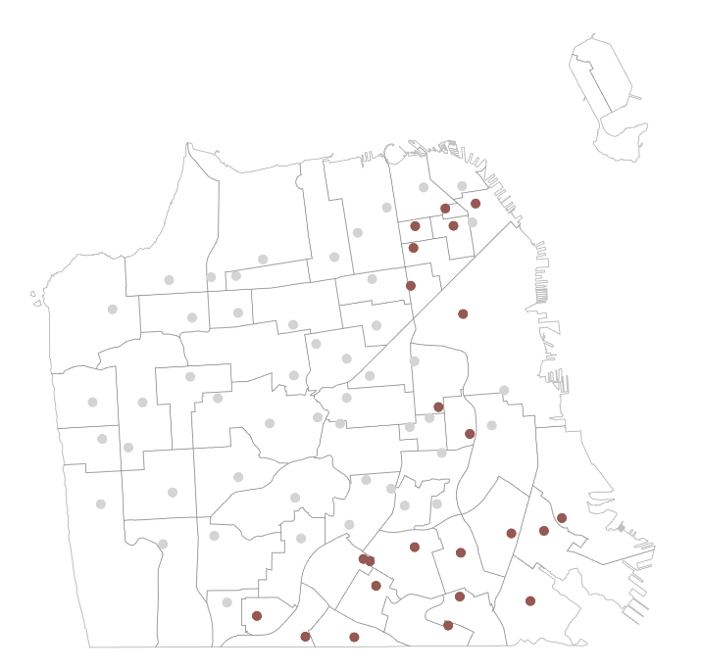
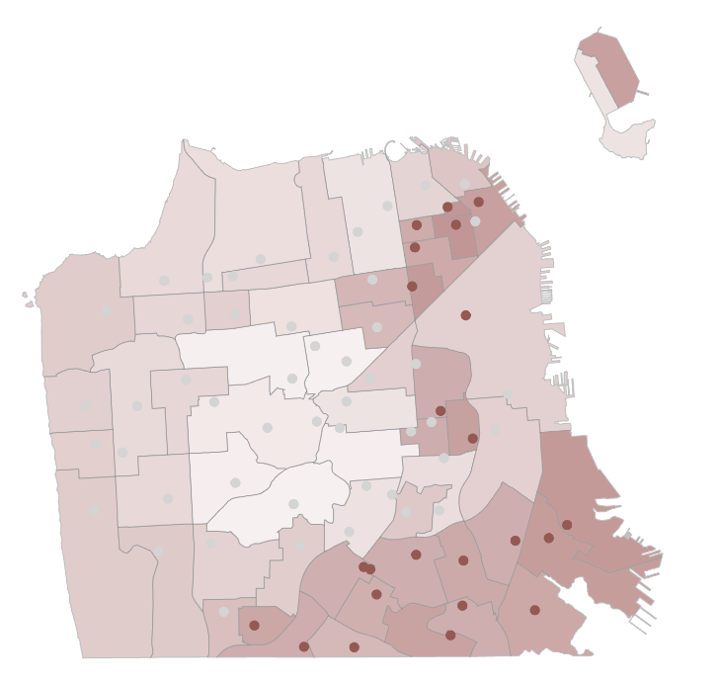
Student assignment matters! But faces challenges…
1971
Race-conscious policies
Schools with highest % students with socio-economic need (eligible for free or reduced-price lunch)
2002
Race-blind policies
#
2011
School Choice
Schools with highest % historically underserved minorities (AALPI)
2020
Controlled Choice
!

Slide 5



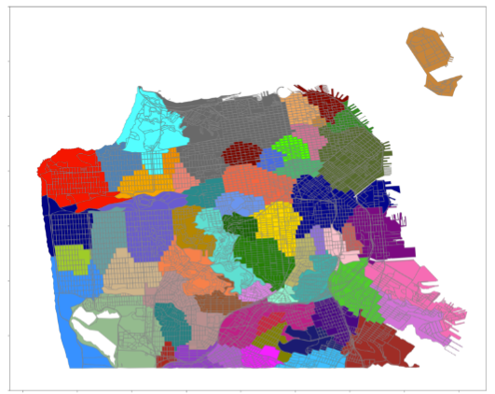
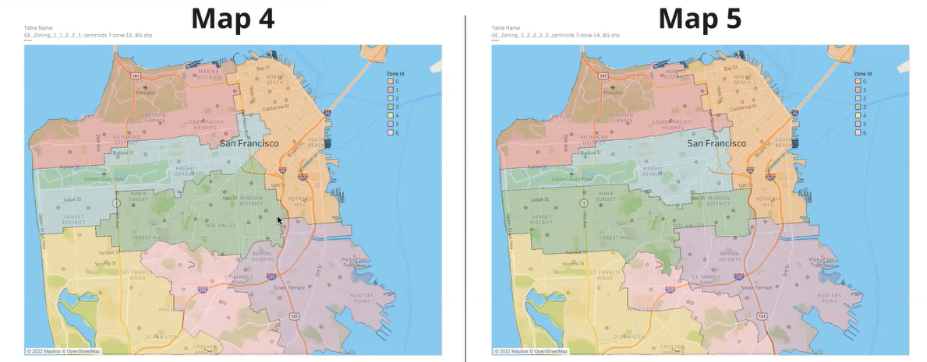
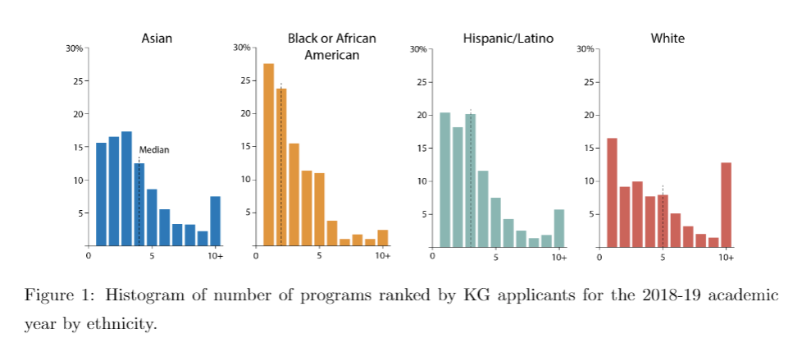
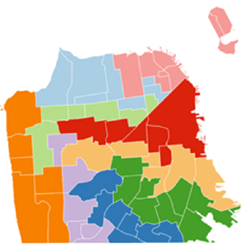

A data science approach
[Allman et al. 2022]
End-to-end simulation tool to test policies and evaluate resulting assignments
Predict families’
choices
Suggest and simulate policies
Visualize and
evaluate policies
White
Black or African
Map 1
Map 2
American
Potential to significantly reduce % of racial minorities in high-poverty schools

Slide 6
Opportunities
Computation
and Prediction
Compute Zones
[Allman et al. 2022, Monarrez 2022, Gillani et al. 2023, Ozel et al. 2023]
Predict Choice
[Abdulkadiroglu et al. 2020,
Allman et al. 2022]

Slide 7

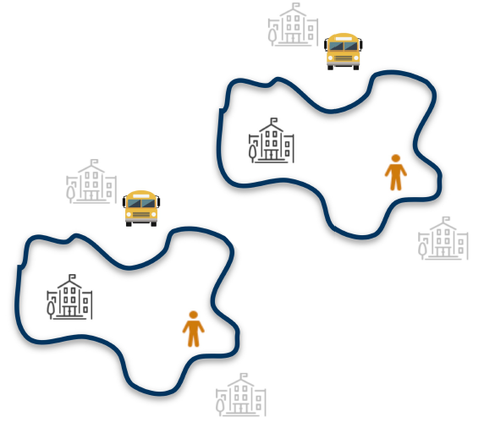


Opportunities
Computation
and Prediction
Additional
Policy Levers
Reserving Seats
[Abdulkadiroglu & Sonmez 2003,
Allman et al. 2022]
Menus
[Shi 2022,
Allman et al. 2022]

Slide 8
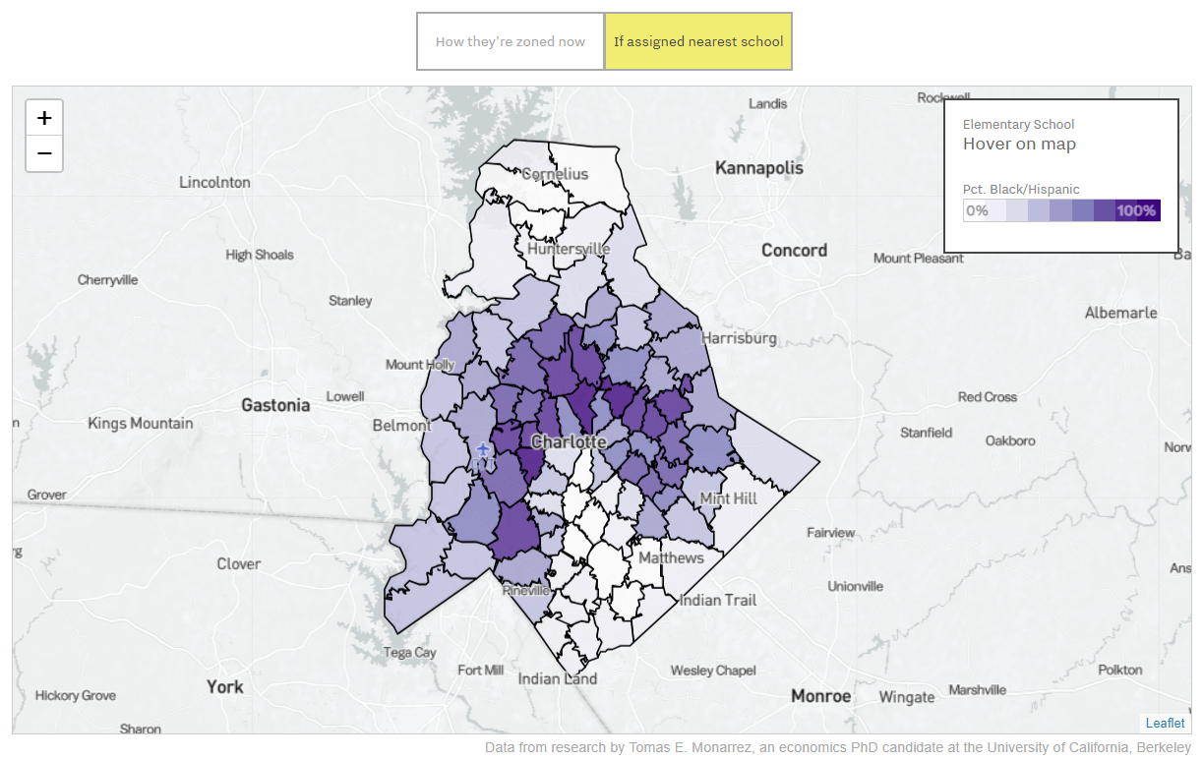
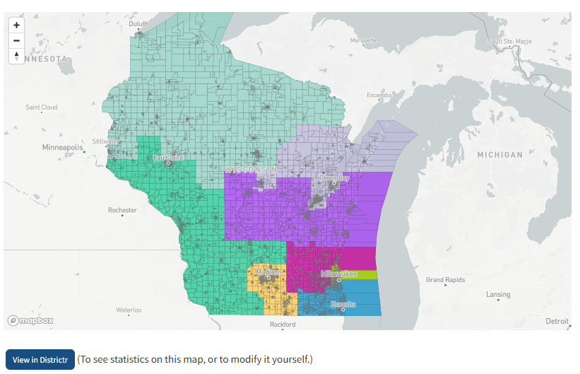

Opportunities
Map 1
Map 2
Computation
and Prediction
Additional
Policy Levers
Interactive
Tools
[Monarrez 2022, Gillani et al. 2023, Duchin et al. 2023, Delarue et al. 2024+, Jeloudar et al. 2024+]
Notes:
[Gillani et al. 2023,
Delarue et al. 2024+,
Jeloudar et al. 2024+]

Slide 9
Interactive Maps: Neighborhood School Zoning [Monarrez 2022]

Slide 10
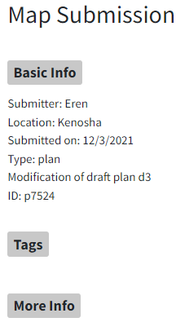
Interactive Maps: Political Redistricting [Duchin et al. 2023]

Slide 11
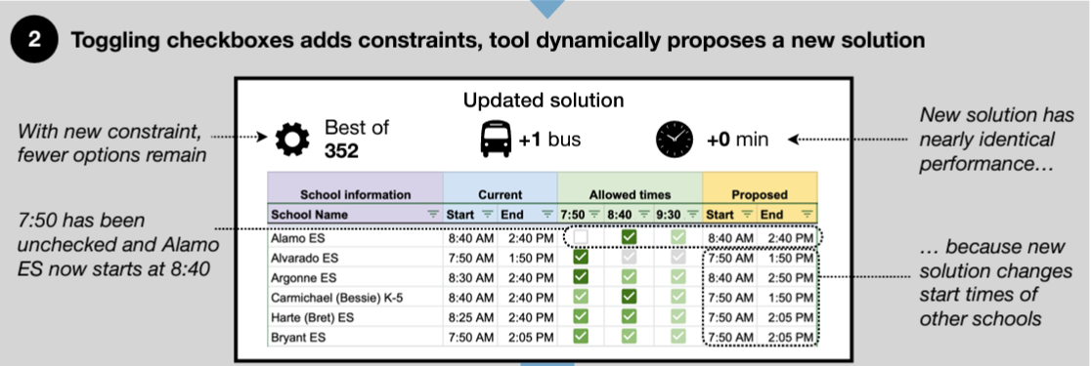
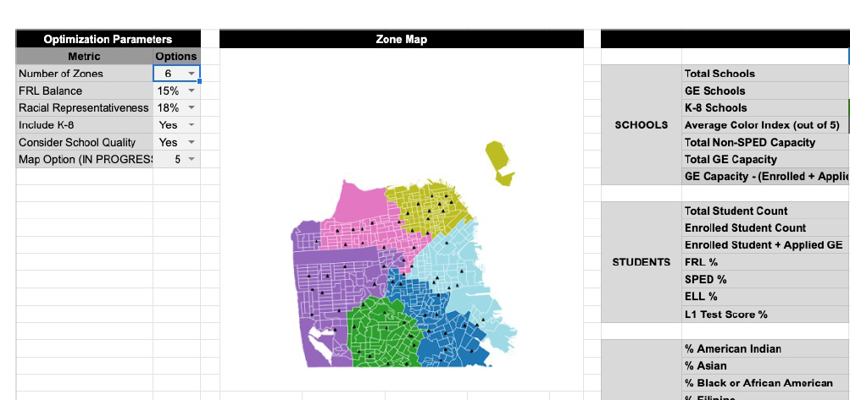
Interactive Spreadsheets [Delarue et al. 2024+, Jeloudar et al. 2024+]

Slide 12

Opportunities
Computation
and Prediction
Additional
Policy Levers
Interactive
Tools
Goals and
Measures
Notes:
[Reardon et al. 2022]

Slide 13

Opportunities
Computation
and Prediction
Additional
Policy Levers
Interactive
Tools
Goals and
Measures
Broader
Effects
Notes:
[Pearman et al. 2022,
Monarrez 2023…]

Slide 14
Thank you!
ilo@stanford.edu

