Slide 1
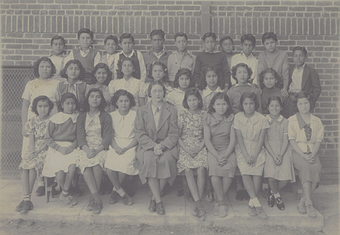
The Long-Run Impacts of
Mexican-American School Desegregation
Kalena Cortes
Texas A&M University
May 6, 2024
Stanford University
The Unfinished Legacy of Brown v Board of Education –
Charting a Path Forward on School Integration and Educational Opportunity

Slide 2
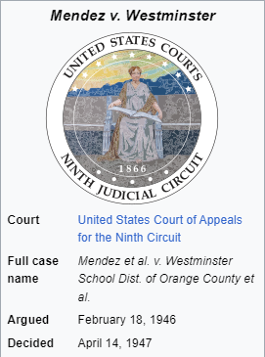
Before Brown v. Board of Education, there was Mendez v. Westminster

Slide 3
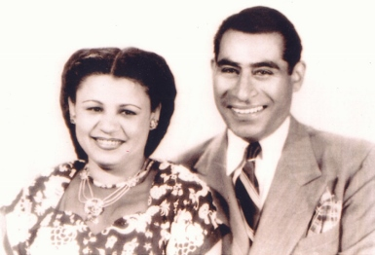
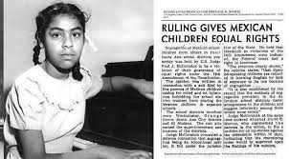
The Mendez Family
Sylvia Mendez (born: Santa Ana, CA in 1936)
She was at the center of the landmark case, Mendez v. Westminster (1947)
American civil rights activist and retired nurse
Gonzalo and Felicitas Mendez
Fought for the rights of all children

Slide 4
The Case: Mendez v. Westminster (1947)
Court ruled that separate schools for Mexicans were unconstitutional
Important first step in the legal fight against school segregation
But the victory was narrow: racial segregation was not addressed by the case
Many of the players in Mendez moved on to the fight for Brown

Slide 5
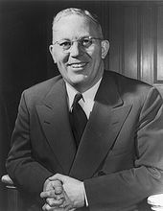

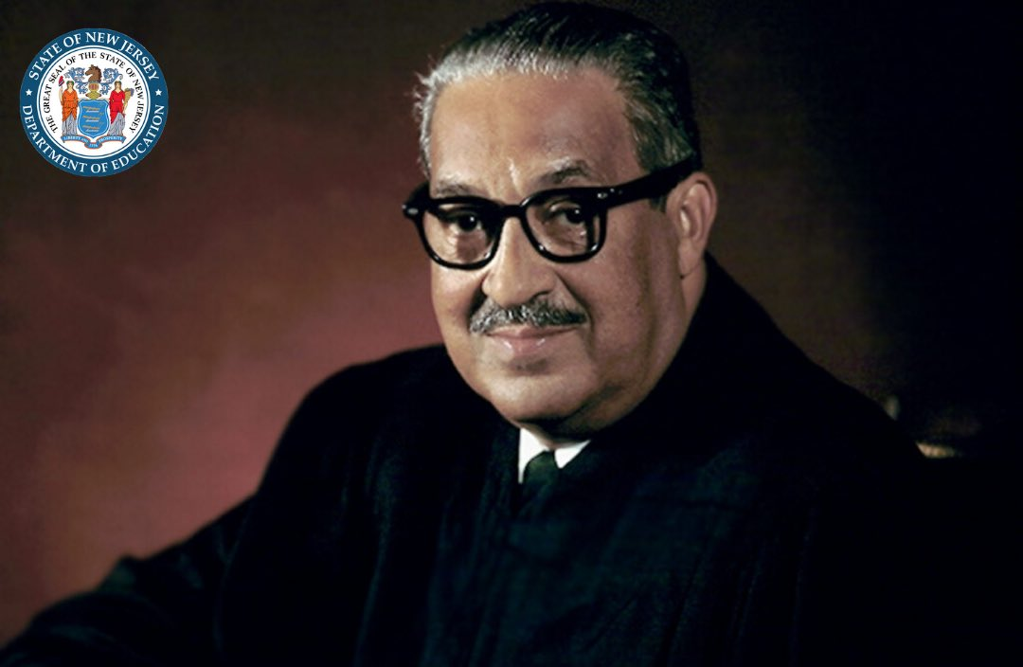
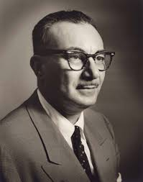


Key Players: Mendez Case (1947)
Earl Warren
American Jewish Congress
Thurgood Marshall
David Marcus
Japanese American Citizens League

Slide 6
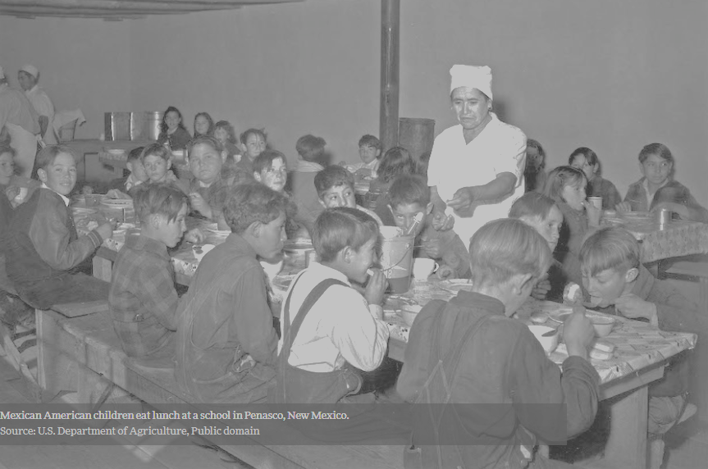

The Long-Run Impacts of
Mexican-American School Desegregation

Slide 7
The Legacy of the Mendez Case
Vast literature on the benefits of African-Americans U.S. desegregation
Less is known about desegregation of Mexican-Americans in U.S. schools
Research Question: What was the impact of school desegregation on educational outcomes for Mexican-Americans?

Slide 8
Key Findings
Mexican-American school desegregation improved educational outcomes
Increased schooling completion in more segregated counties compared with less segregated counties for students starting school after Mendez relative to students that started school earlier
Increased the probability of completing both jr. high and high school

Slide 10
What are the Implications of Our Results?
Spillover Effects: Impacts of desegregation on Non-Hispanic Whites
We find a modest negative impact of desegregation on non-Hispanic whites
But relatively small in magnitude compared to the impacts on Hispanics
These findings are consistent with school resources being shifted from non-Hispanic whites to Hispanic

Slide 11
Concluding Remarks: Policy Relevance
The U.S. is experiencing major demographic changes and rising residential segregation among Hispanics
Hispanics make up one-fifth of U.S. population
Even larger share of U.S. public school population

Slide 12
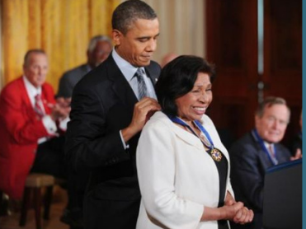
The Legacy of the Mendez Case
Presidential Medal of Freedom (2011)
Mendez Historic Freedom Trail,
7371 Westminster Boulevard

Slide 13

Thank You!
Kalena Cortes
Texas A&M University
kcortes@tamu.edu
@KalenaCortes
Paper QR Code:
Mendez v. Westminster Commemorative Stamp (Sept. 13, 2007)

