Slide 1

The Unfinished Legacy of Brown v. Board of Education at 70
Myron Orfield Presentation
at Stanford University
May 6th, 2024

Slide 2


Slide 3
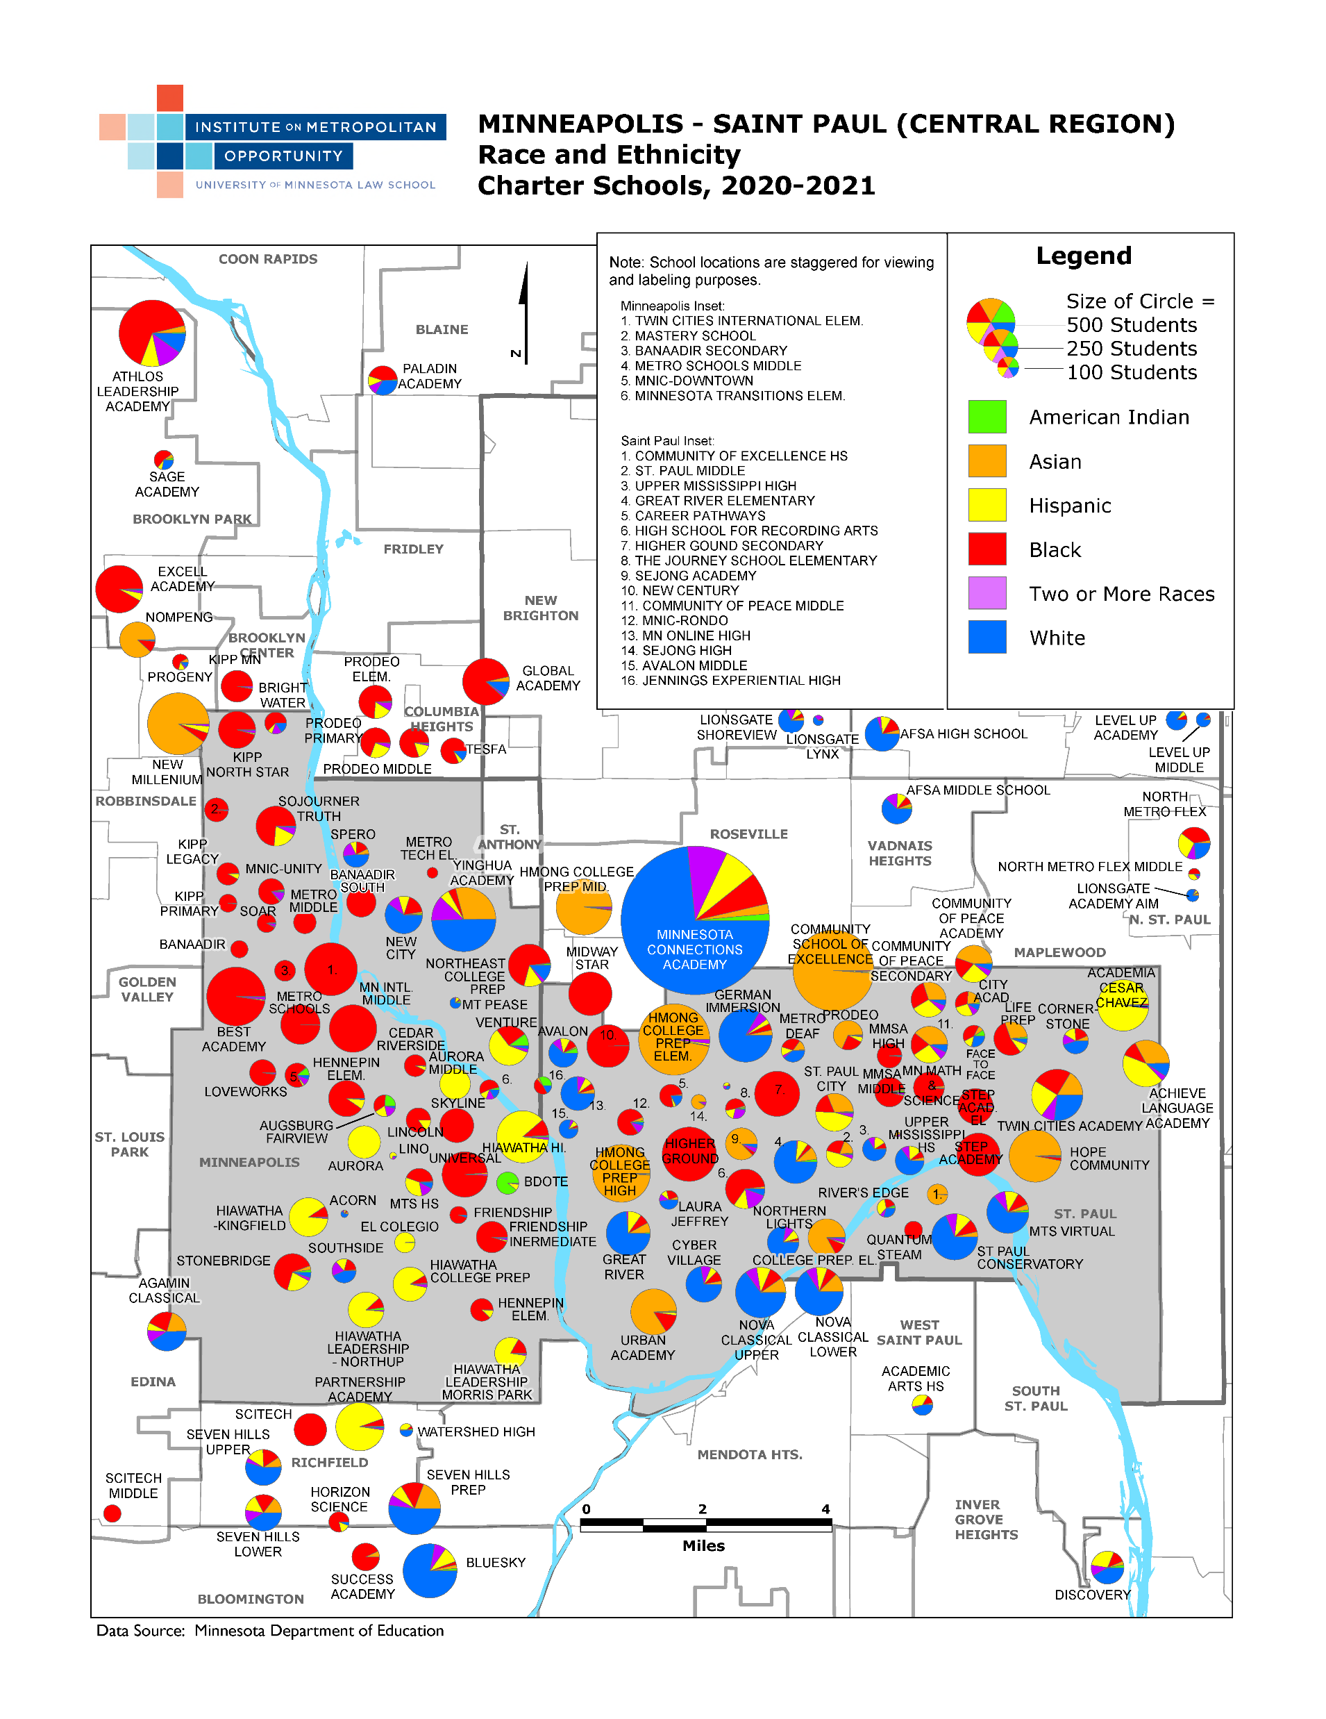

Slide 4


Slide 5
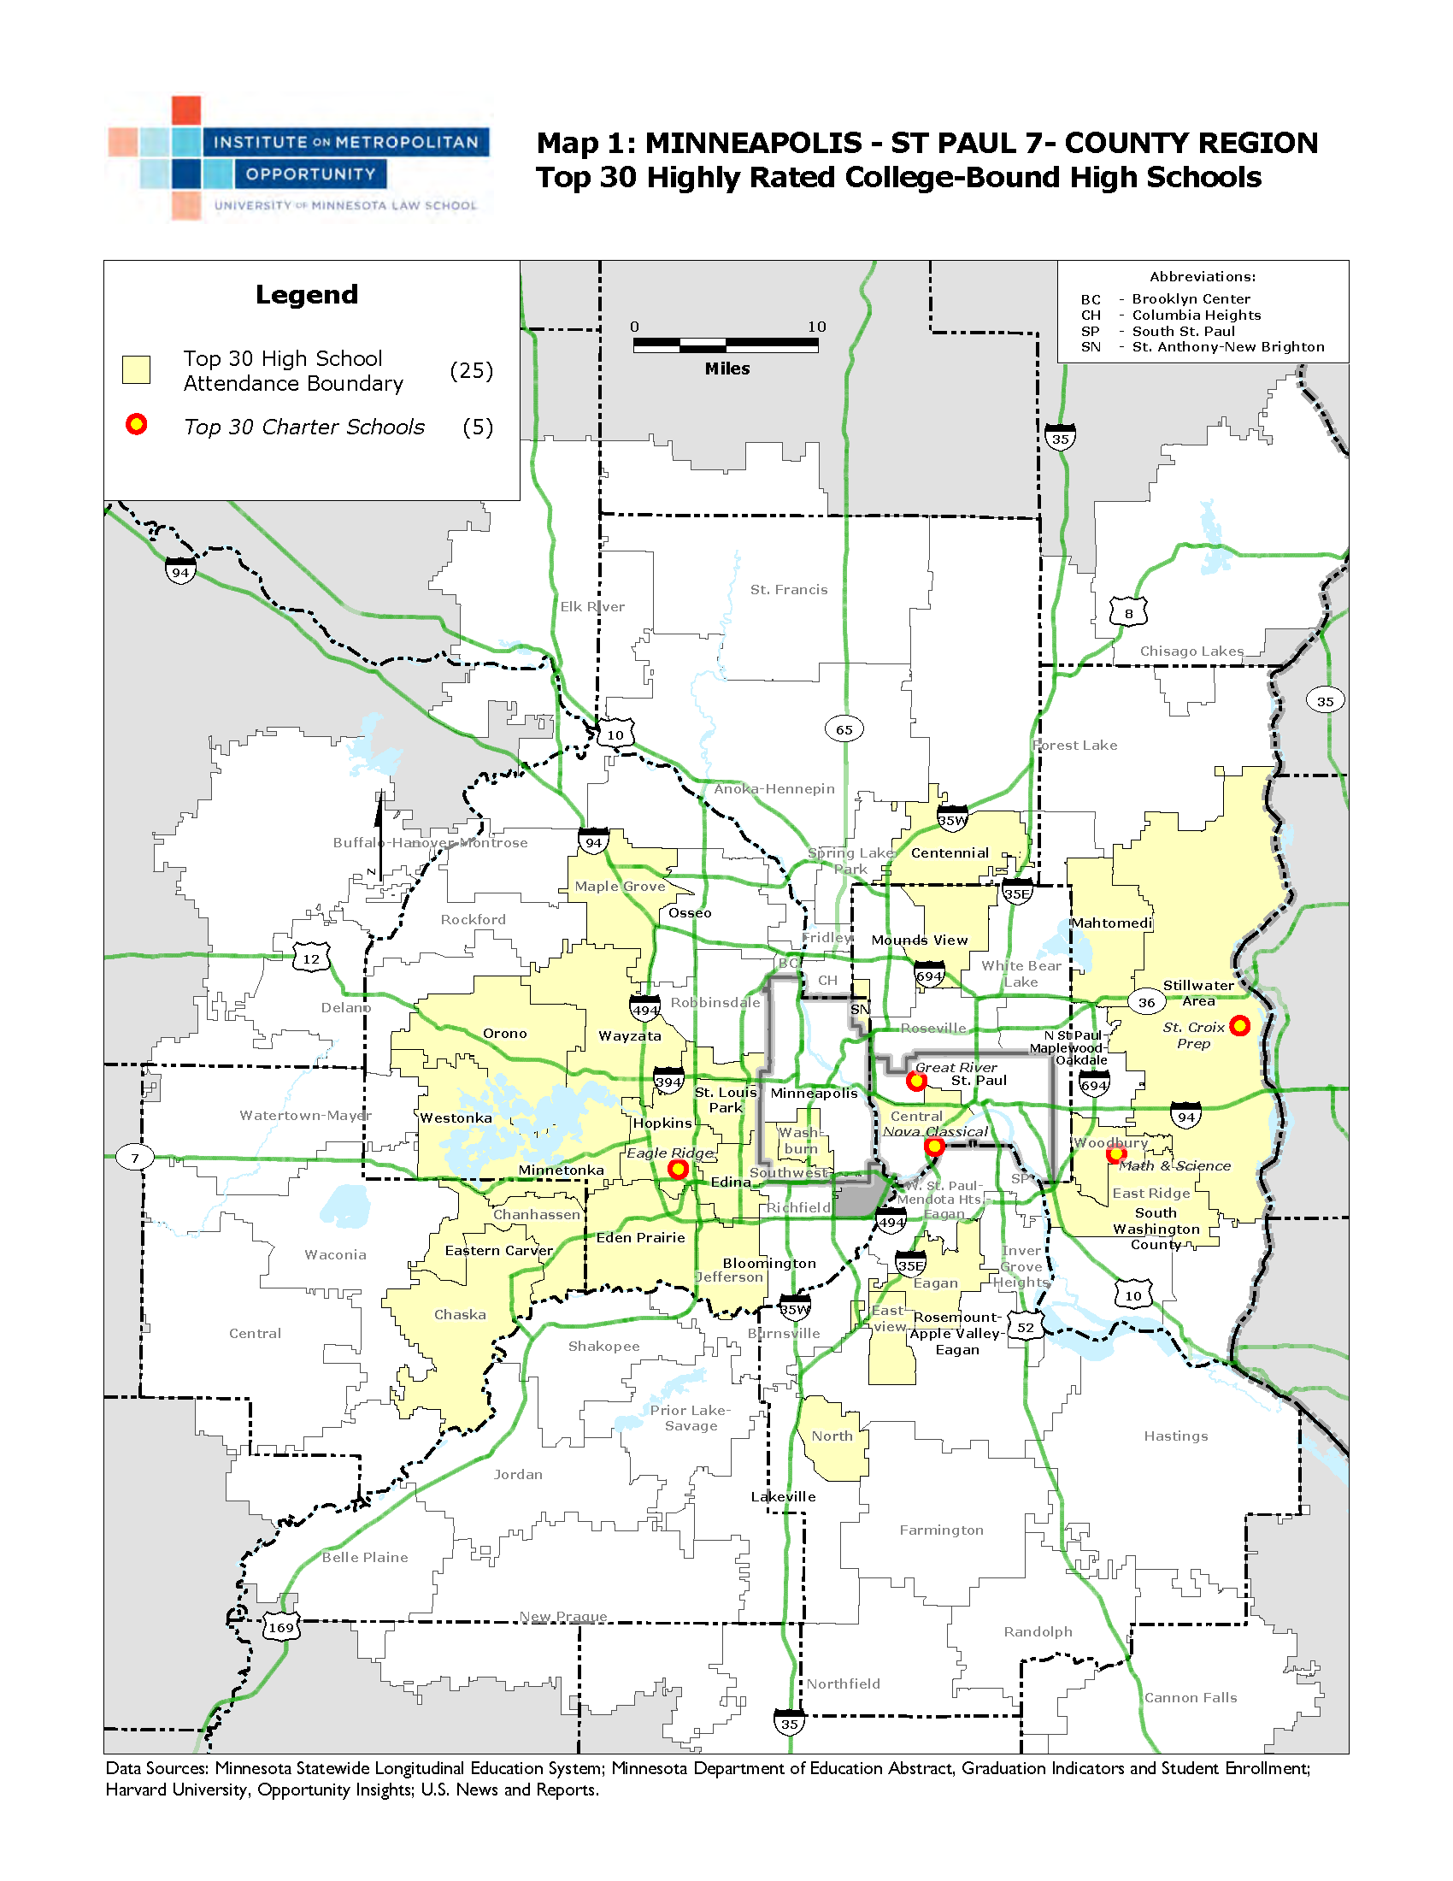

Slide 6


Slide 8

Contact Us:
http://www.law.umn.edu/metro.html

