Slide 1
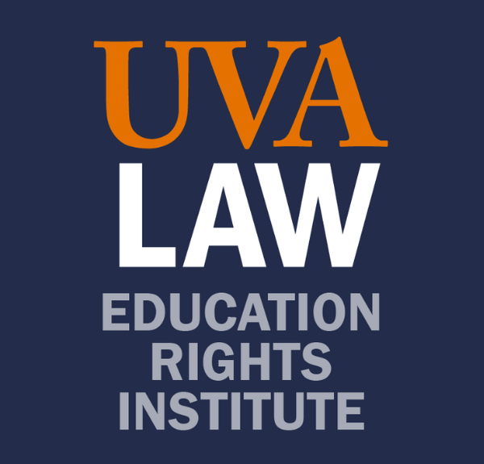
Stanford University
The Unfinished Legacy of Brown v. Board of Education
What Can the Courts Do?:
Legal Strategies to Promote School Integration and Educational Equity
Kimberly Jenkins Robinson,
Martha Lubin Karsh and Bruce A. Karsh Professor of Law, UVA Law
Director, Education Rights Institute
Notes:
THANK YOU

Slide 2
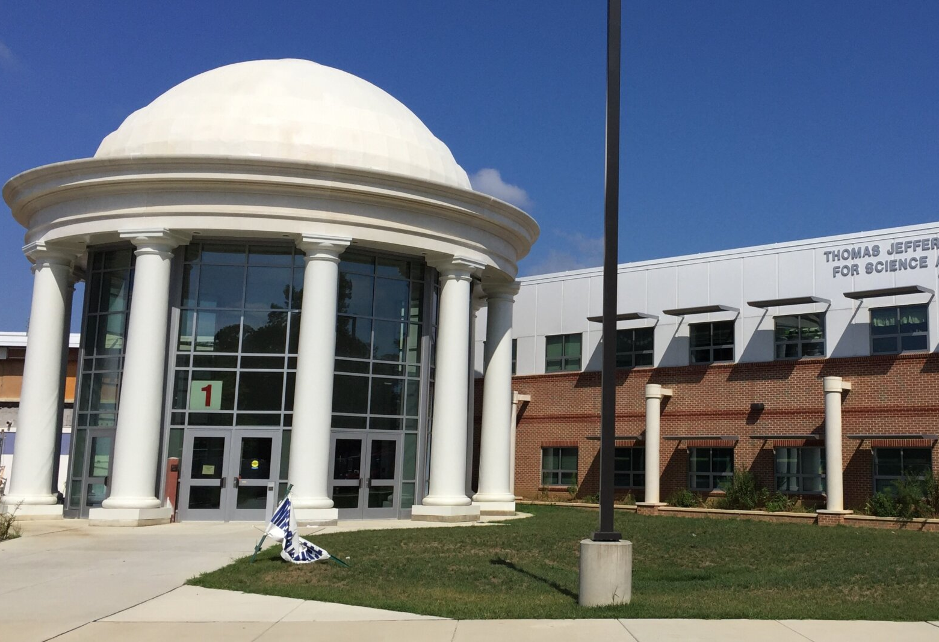
Coalition for TJ v.
Fairfax County School Board 4th Cir. 2023

Slide 3

Borel v.
School Board Saint Martin Parish
5th Cir. 2022

Slide 4
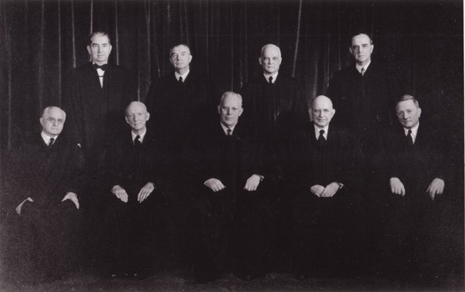
Question Presented in Brown
Does segregation of children in public schools solely on the basis of race, even though the physical facilities and other ‘tangible’ factors may be equal, deprive the children of the minority group of equal educational opportunities? We believe that it does.

Slide 5
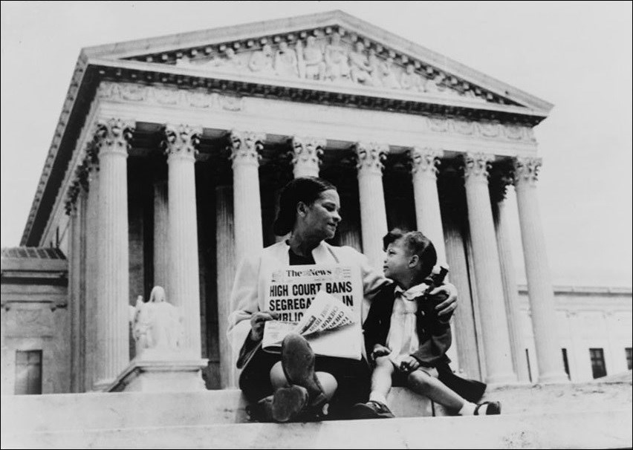
Brown’s Commitment to Equal Educational Opportunity
Such an opportunity, where the state has undertaken to provide it, is a right which must be made available to all on equal terms.”

Slide 6
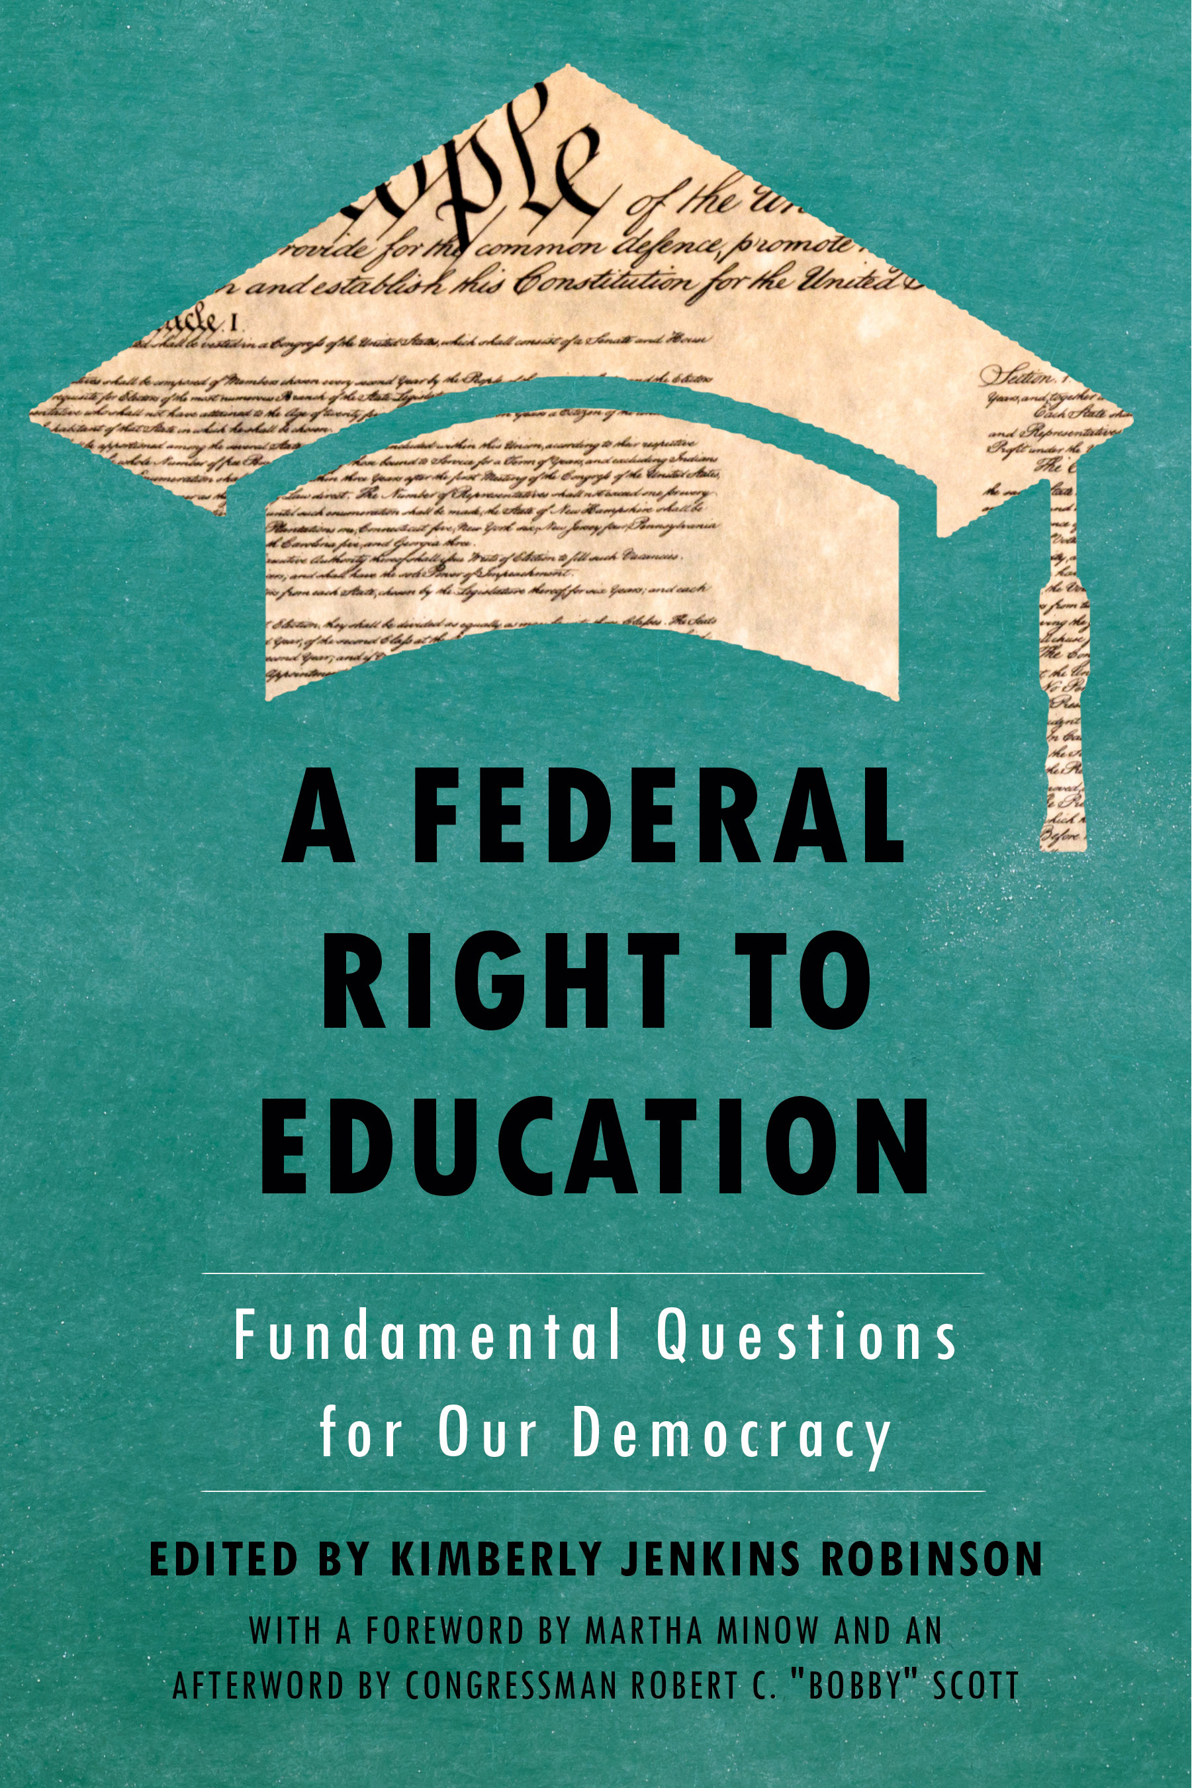
Why?
How?
What?

Slide 7
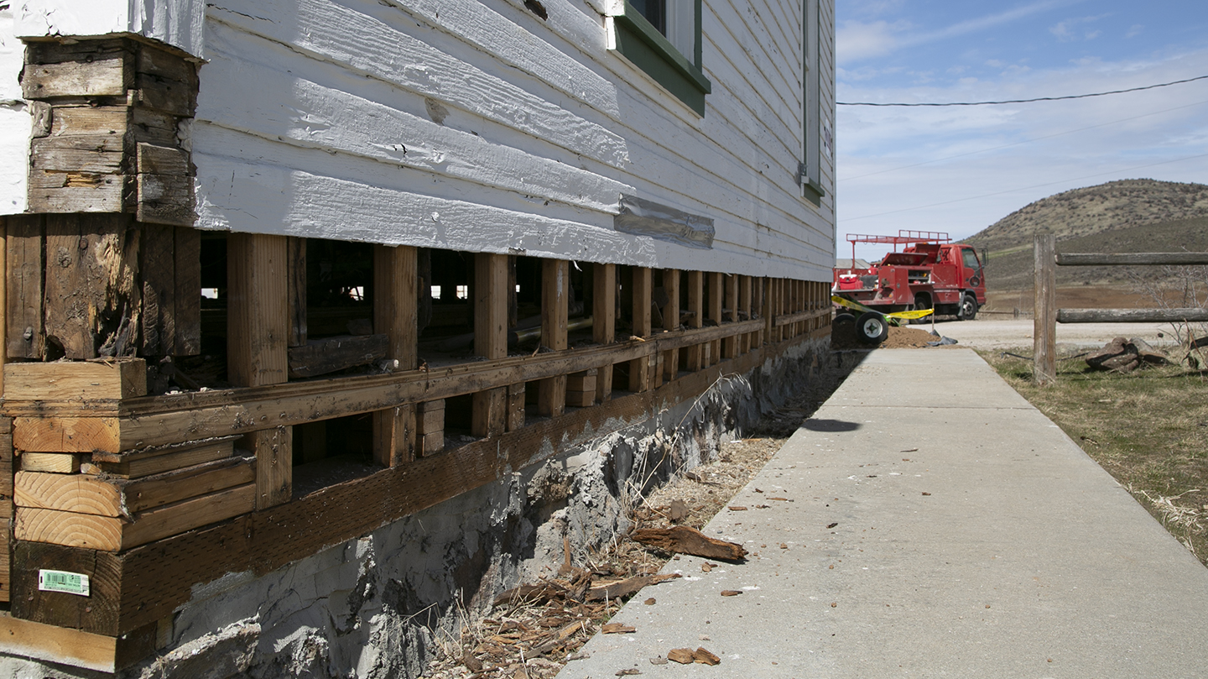

Slide 8


Slide 9
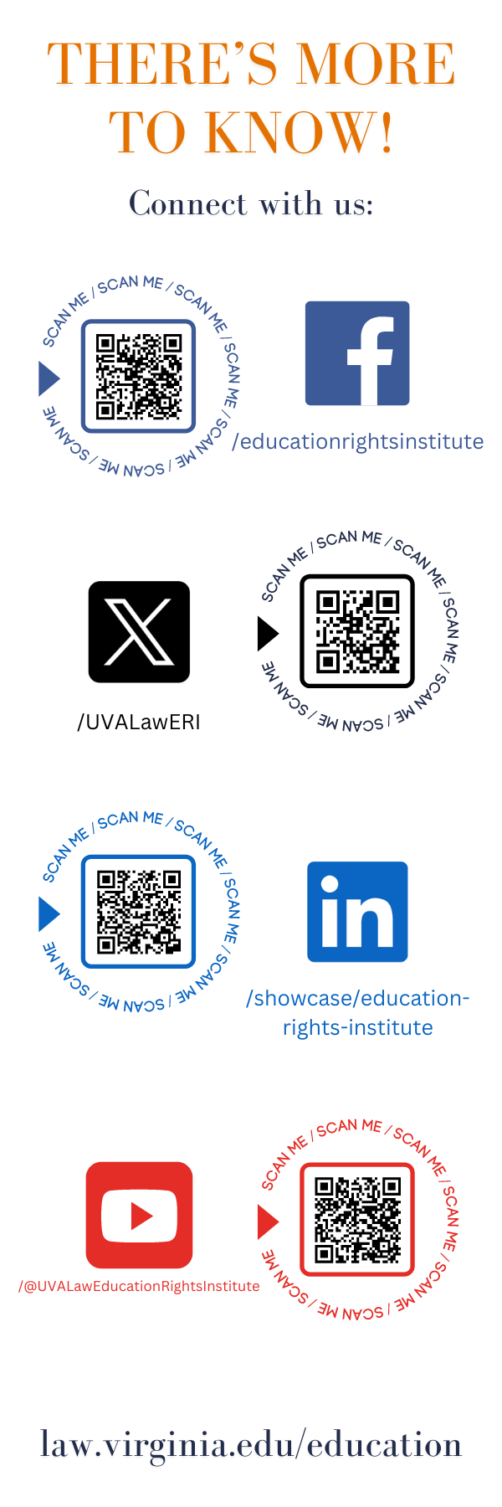
Connect with us:

